Slide 1
Wellington Heath NDP Transport Sub-Group ideas for a safe route to Ledbury for walkers and cyclists
Input to Ledbury Town Council after an exploration of the options suggested in the Wellington Heath working paper by Phillip Howells – 17th June 2016

Slide 2
Wellington Heath NDP calls for providing a safe route for walkers and cyclists from Wellington Heath to Ledbury
Currently most who walk or cycle appear to use one of two road routes:
  From the top end of Wellington Heath: Jacks Lane – Ledbury Road - Beggars Ash – Bromyard road route
  From the middle of Wellington Heath: Farmers Arms – Horse Road – Beggars Ash – Bromyard road
Both are along bending, narrow and quite dangerous roads, especially for the last half mile or so from The Frith to the junction of Beggars Ash with the main Bromyard road into Ledbury
Options to provide safer routes off-road to reach key landmarks of Ledbury railway station and the Tesco supermarket have been investigated
If safer options are coordinated through the two NDPs, this can also establish a currently missing link into the public rights of way network spanning the two parishes and beyond, such as extending the Riverside Walk and Town Trail, which would also be a way of helping to deliver parts of the Herefordshire County Core Strategy
This references to bullet points LB1 5, 6 & 7 in the Core Strategy

Slide 3
This report concerns itself mainly with options that fall into the Ledbury Town parish borders from where they abut to Wellington Heath
Please note it is based on the author’s ‘on the ground’ experience and may not reflect deeper knowledge of land owners and path options that are not apparent or known to the author
To try and simplify cross-reference, this report uses the same letter point identifiers as in the Wellington Heath sub-group report (some letter duplications reflect where they have sometimes used 2 letters to identify the same point)
Points 1, 2 & 3 are only used in this report
The options explored in this report therefore start from The Frith on Beggars Ash, referred to as The Oak in the Wellington Heath report, point J or A on the map
Additional notes:
  There are several more footpaths from Wellington Heath generally heading east to a footpath above the orchards which goes from Little Frith to the Wellington Heath/Petty France road and which are usable on foot as access to Ledbury, although they are more hilly and much longer
  A good and safe cycling option is to go north east from Wellington Heath to Raycombe Farm and half way down Petty France road to turn right up a metalled track that goes all the way through the lower part of Frith woods and eventually comes out at the top of Knapp Lane – again, this is longer

Slide 4
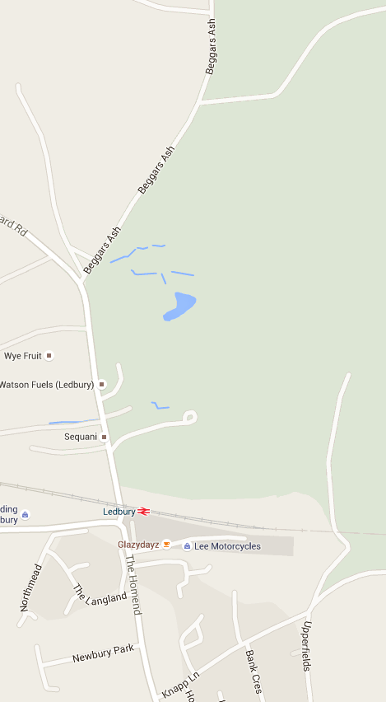
‘Viable’ route options (5 shown)
From L
As identified by Wellington Heath:
By road J-B-S to station and Tesco as currently used
Cut new route A-D-F-C through orchards
Cut new route J-W-V-U (same as A-D-E-C) through orchards
Existing path J-N-P-T (The Frith – orchards – Little Frith – Wilce’s Orchard – to stile at T on Bromyard Road) to reach station
Existing path J-N-P-Q-R (The Frith – orchards – Little Frith – Knapp Lane) to reach Tesco
Note that at the top of map, the route from Wellington Heath to The Frith is an existing footpath
L-M-J in Wellington Heath report, from Long Acre in Horse Road to join up with options in this report at J
Issues considered in this report:
Perceived on the ground practicality of path options
Potential use of options by both walkers and cyclists to optimise practical adaption
J
N
A
W
D
F
1
B
V
E
U
C
P
3
T
2
A
S
Q
R

Slide 5
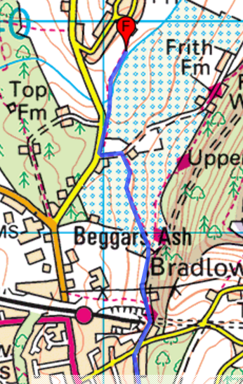
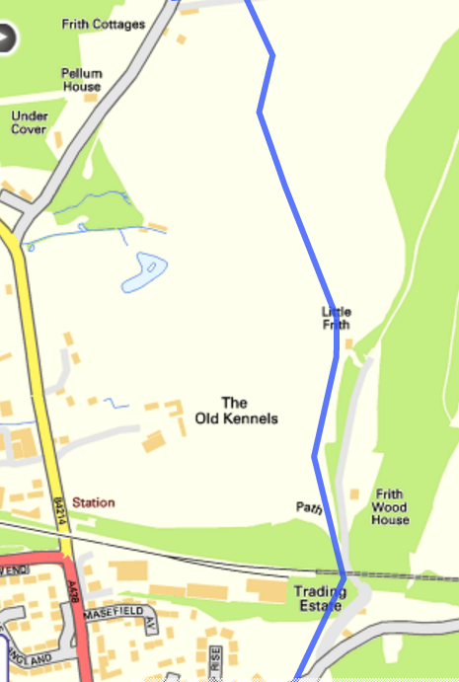
Two other maps of the existing paths (found as an existing recommended walk on the internet):
- Left hand shows path from Horse Road/Long Acre (point F) via The Frith - orchards – Little Frith – Knapp Lane (L-J-N-P-Q)
- Right hand shows N-P-Q in more detail

Slide 6
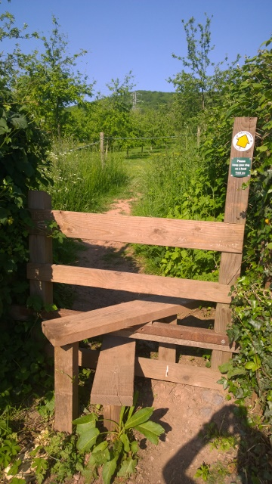
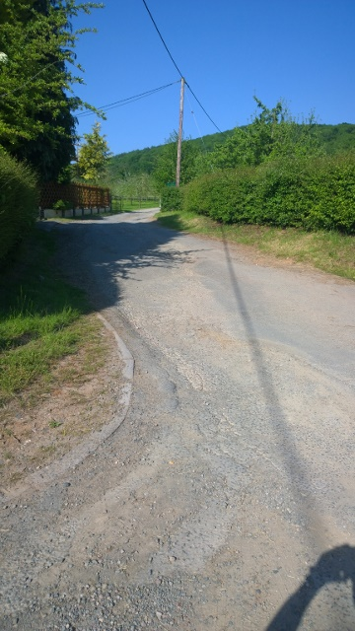
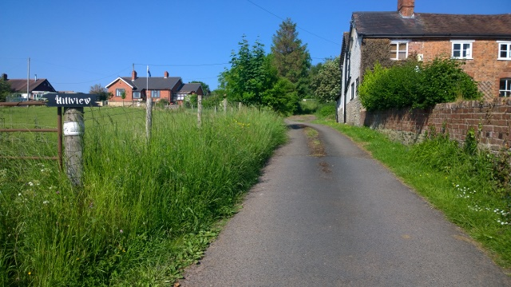
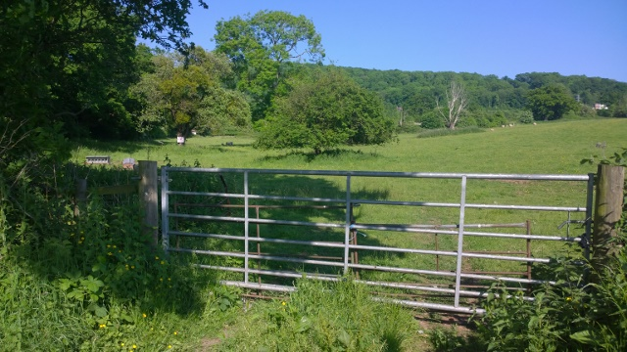
Existing and possible path exit points on map onto Bromyard Road:
T - existing stile from Wilce’s orchard by the station
3 – drive opposite Sequani
U/C – Hillview drive near U/C point
B – gate at junction of Beggars Ash and Bromyard Road looking up into the orchards (note Private signs)
U/C
T
3
B

Slide 7
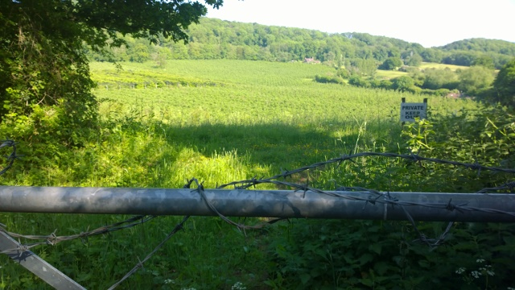
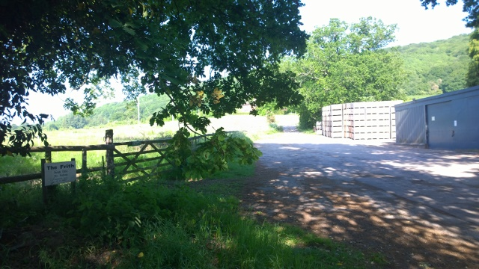
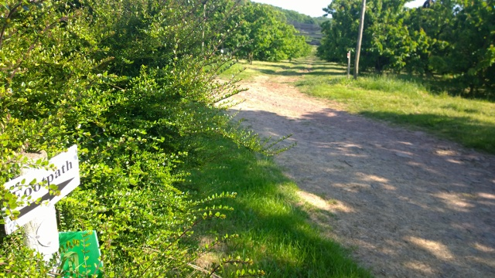
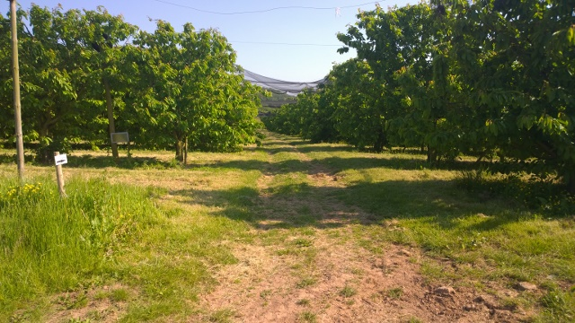
From Bromyard Road up Beggars Ash to The Frith
F – View across orchards where any proposed new path would pass (note Private sign)
A/J – The Frith drive from Beggars Ash, gate on left is where path from L arrives, ahead up drive to point N in distance (W/D would be on right just past fence, no current path exists?)
N – Left hand pic, footpath turns south towards Little Frith at top of The Frith drive, right hand pic 50 yards further on looking along the footpath across the orchards south towards Little Frith and points 1 and P
F
A/J
N
N

Slide 8
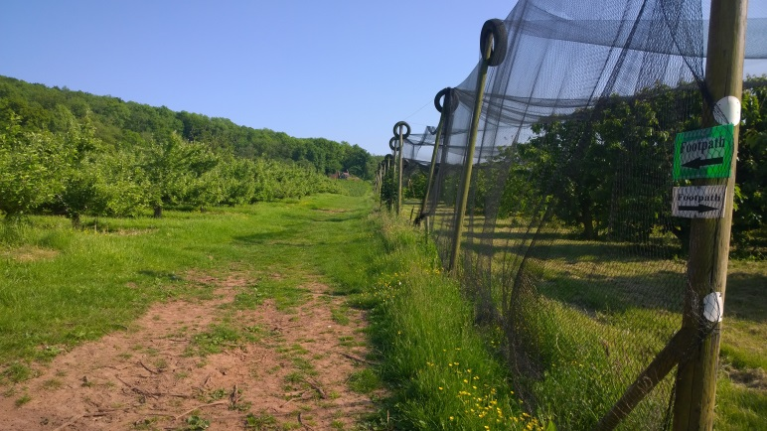
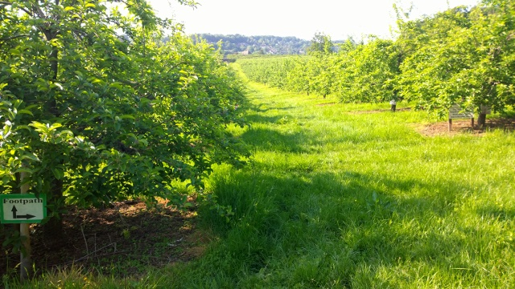
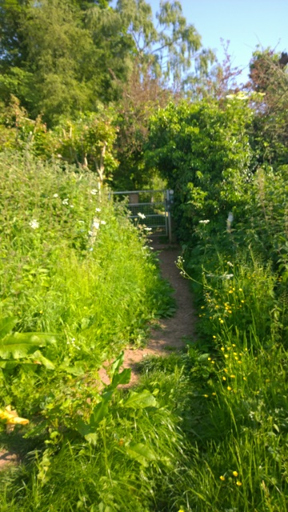
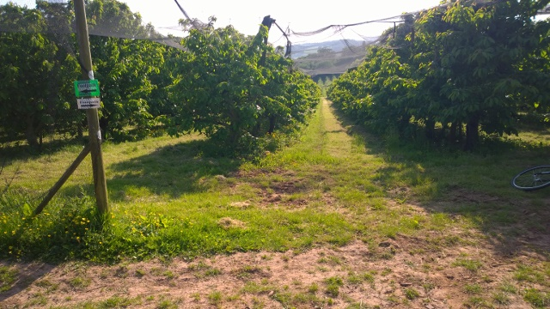
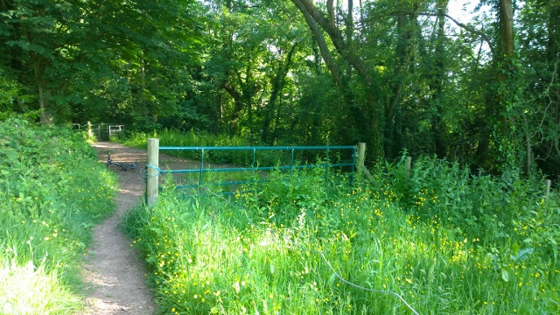
From The Frith to Little Frith and then Knapp Lane
1 – Top pic looking south on the path towards Little Frith, bottom pic looking west down towards the Bromyard Road and illustrating the sort of countryside any new path will have to be cut to reach points V/E, U/C or 3
P – Top pic looking back north along the path towards The Frith from Little Frith; right hand pic looking south on the path leading into the garden of Little Frith on the way to Knapp Lane
2 – looking south on the footpath near Frith Wood House, walkers turn right down hill to T on Bromyard Road, cyclists or walkers ahead through kissing gate to Q and up to Knapp Lane and town
P
P
1
2
1

Slide 9
Conclusions:
Whilst right to look at all options, with the caveat of not knowing nuances of ownership etc, given geographic and ownership challenges against a background of ‘Private Signs’, cutting new paths would seem unlikely, be time consuming and relatively expensive
The only viable practical ‘safe route’ option for both walkers and cyclists appears to be on The Frith – Little Frith route
For walkers this is J-N-1-P-2-T, for cyclists or walkers J-N-1-P-2-Q-R
Pros: the path exists, is already promoted as a tourist path, is mainly wide, it’s rolling but not unduly hilly and it’s readily passable by both walkers and mountain bikers (2 gates at Little Frith and kissing gate by Frith Wood House both easily negotiated by cyclists - the author rode it on his bike; style at T only suitable for walkers)
It also has greatest potential to meet Core Strategy and NDPs objectives
Disadvantages are:
  Section N-P is across orchards used by tractors so would be muddy and rutted in wet weather and churned up by wheels
  It is quite long although not hugely greater than the road route
Would not be difficult to install a hard core surface making N-P more permanent and less damaged by tractors, so could both suit farmers and make route more suitable for less rugged and non-mountain bikes
Options exist from top of Knapp Lane to use Upper Fields, Bank Crescent and Homend Crescent/down the steps through garage (with permission?) to reach Tesco and town
Could also consider a white lined pedestrian lane with ‘Warning walkers and cyclists’ signs on Beggars Ash, especially from The Frith to the Bromyard Road (J-B)

